Slide 1
Study Skills Workshop
March 2024

Slide 2
Discussion
In your group, discuss which revision techniques you used in preparation for the prelims and/or are currently using to revise.
Write each technique on a separate post-it.

Slide 3
Learning Intentions
We are learning about effective study techniques, specifically how to evaluate the effectiveness of each technique and create a bank of techniques for you to use.

Slide 4
Success Criteria
I can list different study techniques.
I can evaluate the effectiveness of different techniques.
I can create a bank of effective techniques which I could use to revise, and identify when each would be most effective.

Slide 5
Revision Techniques
Past Paper Questions
Mind Maps
Flashcards
Study Guides
Reading Notes
Typing notes
Highlighting notes
Summarising notes
Creating rhymes, stories or mnemonics
Using sticky notes to summarise/ organise information
Working in study groups
Which are passive and which are active study techniques?

Slide 6
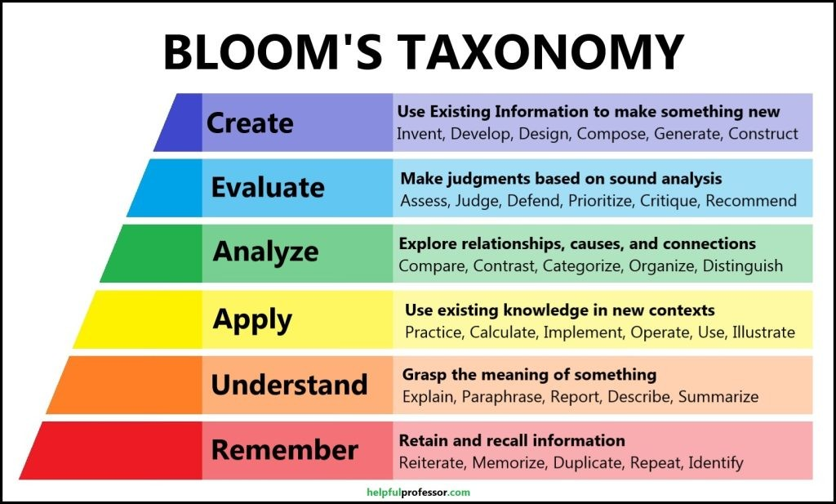

Slide 7
Group Discussion
In your group from earlier, rank your study skills in order of most effective to least effective.

Slide 8
Active Study Techniques - Creating a Study Guide
Creating revision materials is a really effective way to study, rather than using materials made by someone else.
While reading through notes may aid understanding of concepts, understanding what is written is not the same as explaining a concept in an exam.

Slide 9
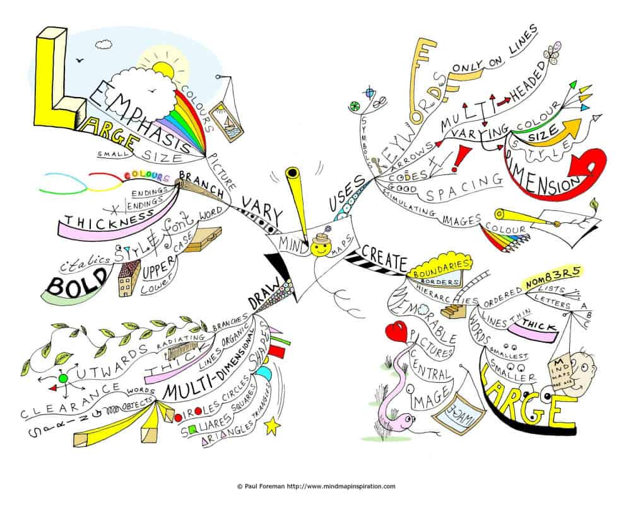

Slide 10
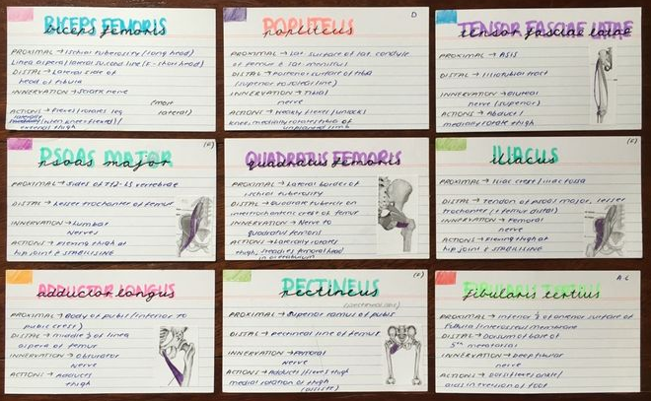
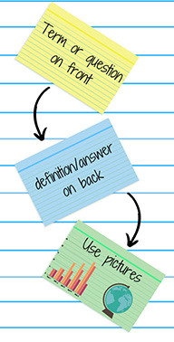

Slide 11
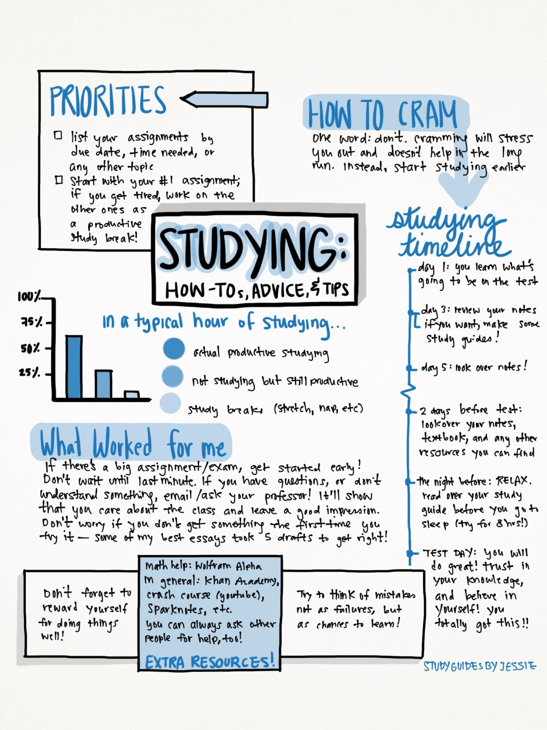
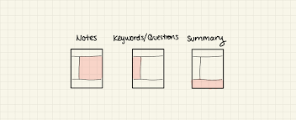

Slide 12
Summarising Your notes
Use headings and subheadings
Keep your notes as short as possible
Make them as visual as possible - use highlighters, colour, pictures, bullet points
Use your own words as much as possible
Include key terms and definitions

Slide 13
Question and Answer format
An effective way of organising your Study Guide/ flashcards/ mindmaps is using the Question and Answer format.
Top tips:
Make questions meaningful (Use how/ why questions as much as possible)
Pose Qs in both directions - define a term, state a term from given definition.
Test content in multiple ways - in an exam you may be asked for the same solution using different questions - state, explain, define, calculate, show etc.
Look for opportunities to make questions bigger to allow you to connect ideas and content from the whole course. This aids understanding and allows you to see where your fact fits in.

Slide 14
How to use your study guide effectively
Guess answers from the start
Randomise questions each time you run through them (shuffle flashcards or skip through pages of notes/ mind maps)
Speak aloud when answering questions
Explain/ pretend to teach someone else
Keep studying what you get right (protects against forgetting)

Slide 15
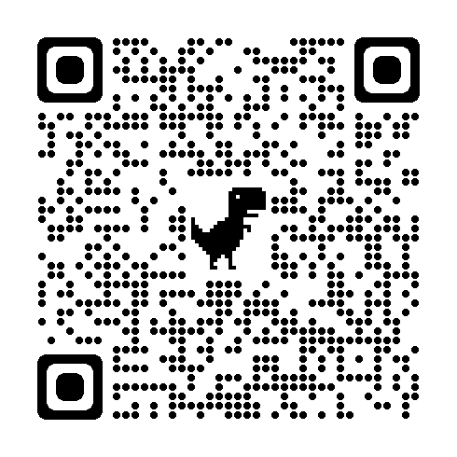
Survey
Please take a few minutes to complete the following survey on Google Forms.
https://forms.gle/garZhqAvqcxQu78A6

